Slide 1
Park Cedar Rapids Finance Committee Presentation
October 15th, 2020

Slide 2
Pre Covid
Post Covid
3907 Monthly Parkers
Occupancy
3rd Ave, 4th Ave, GTC, Southside – 90+%
Onstreet Transactions
17k-24k per month
30% Pay by Phone
2589 Monthly Parkers
Occupancy
3rd, 4th Ave Ramps -15-18%
Southside – 4-6%
Convention Center – 25%*
GTC – 40-48%
Onstreet Transactions
7-8k per month
40% Pay by Phone

Slide 3
Profit & Loss Through August 2019 | Profit & Loss Through August 2020
Meter Daily $ 1,472,933.78 | Meter / Daily $343,443.17
Monthly Permit $ 3,592,777.44 | Monthly Permit $1,063,271.37
Citations $ 286,025.18 | Citations $77,632.93
Event Parking $ 387,438.81 | Event Parking $55,112.00
Misc / Other $ 241,374.68 | Misc / Other $100,370.50
Office / Admin $615,642.74 | Office / Admin $ 277,160.13
Payroll $2,137,958.73 | Payroll $778,482.94
Purchased Services $ 490,397.60 | Purchased Services $ 190,164.36
Routine Services $ 1,551,080.84 | Routine Services $ 592,537.80
Net Operating Income $ 1,070,469.98 | Net Operating Income -$197,329.26

Slide 4
2018 - $1,018,405
2019 - $1,273,645
2020 - $ - 316,525
CASH RESERVES$ 1.3M

Slide 5
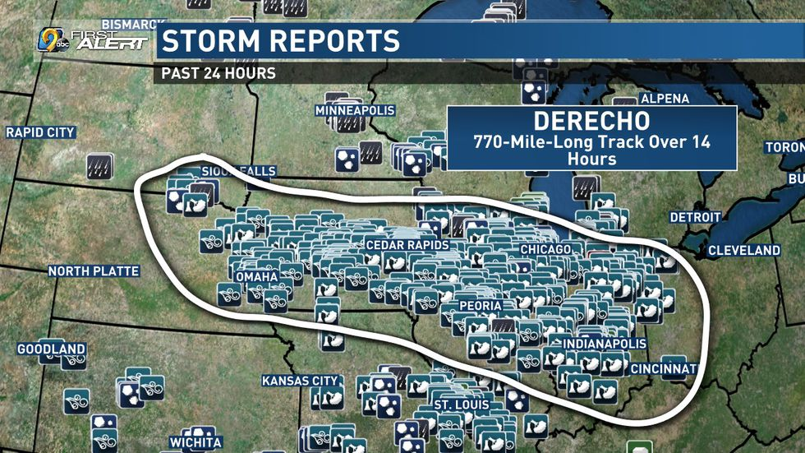
DERECHO 2020

Slide 6
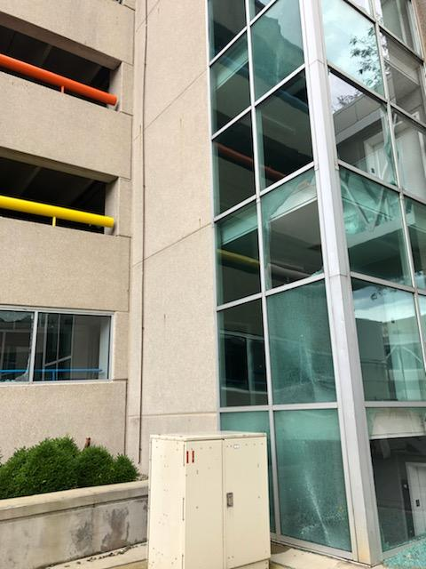

Slide 8
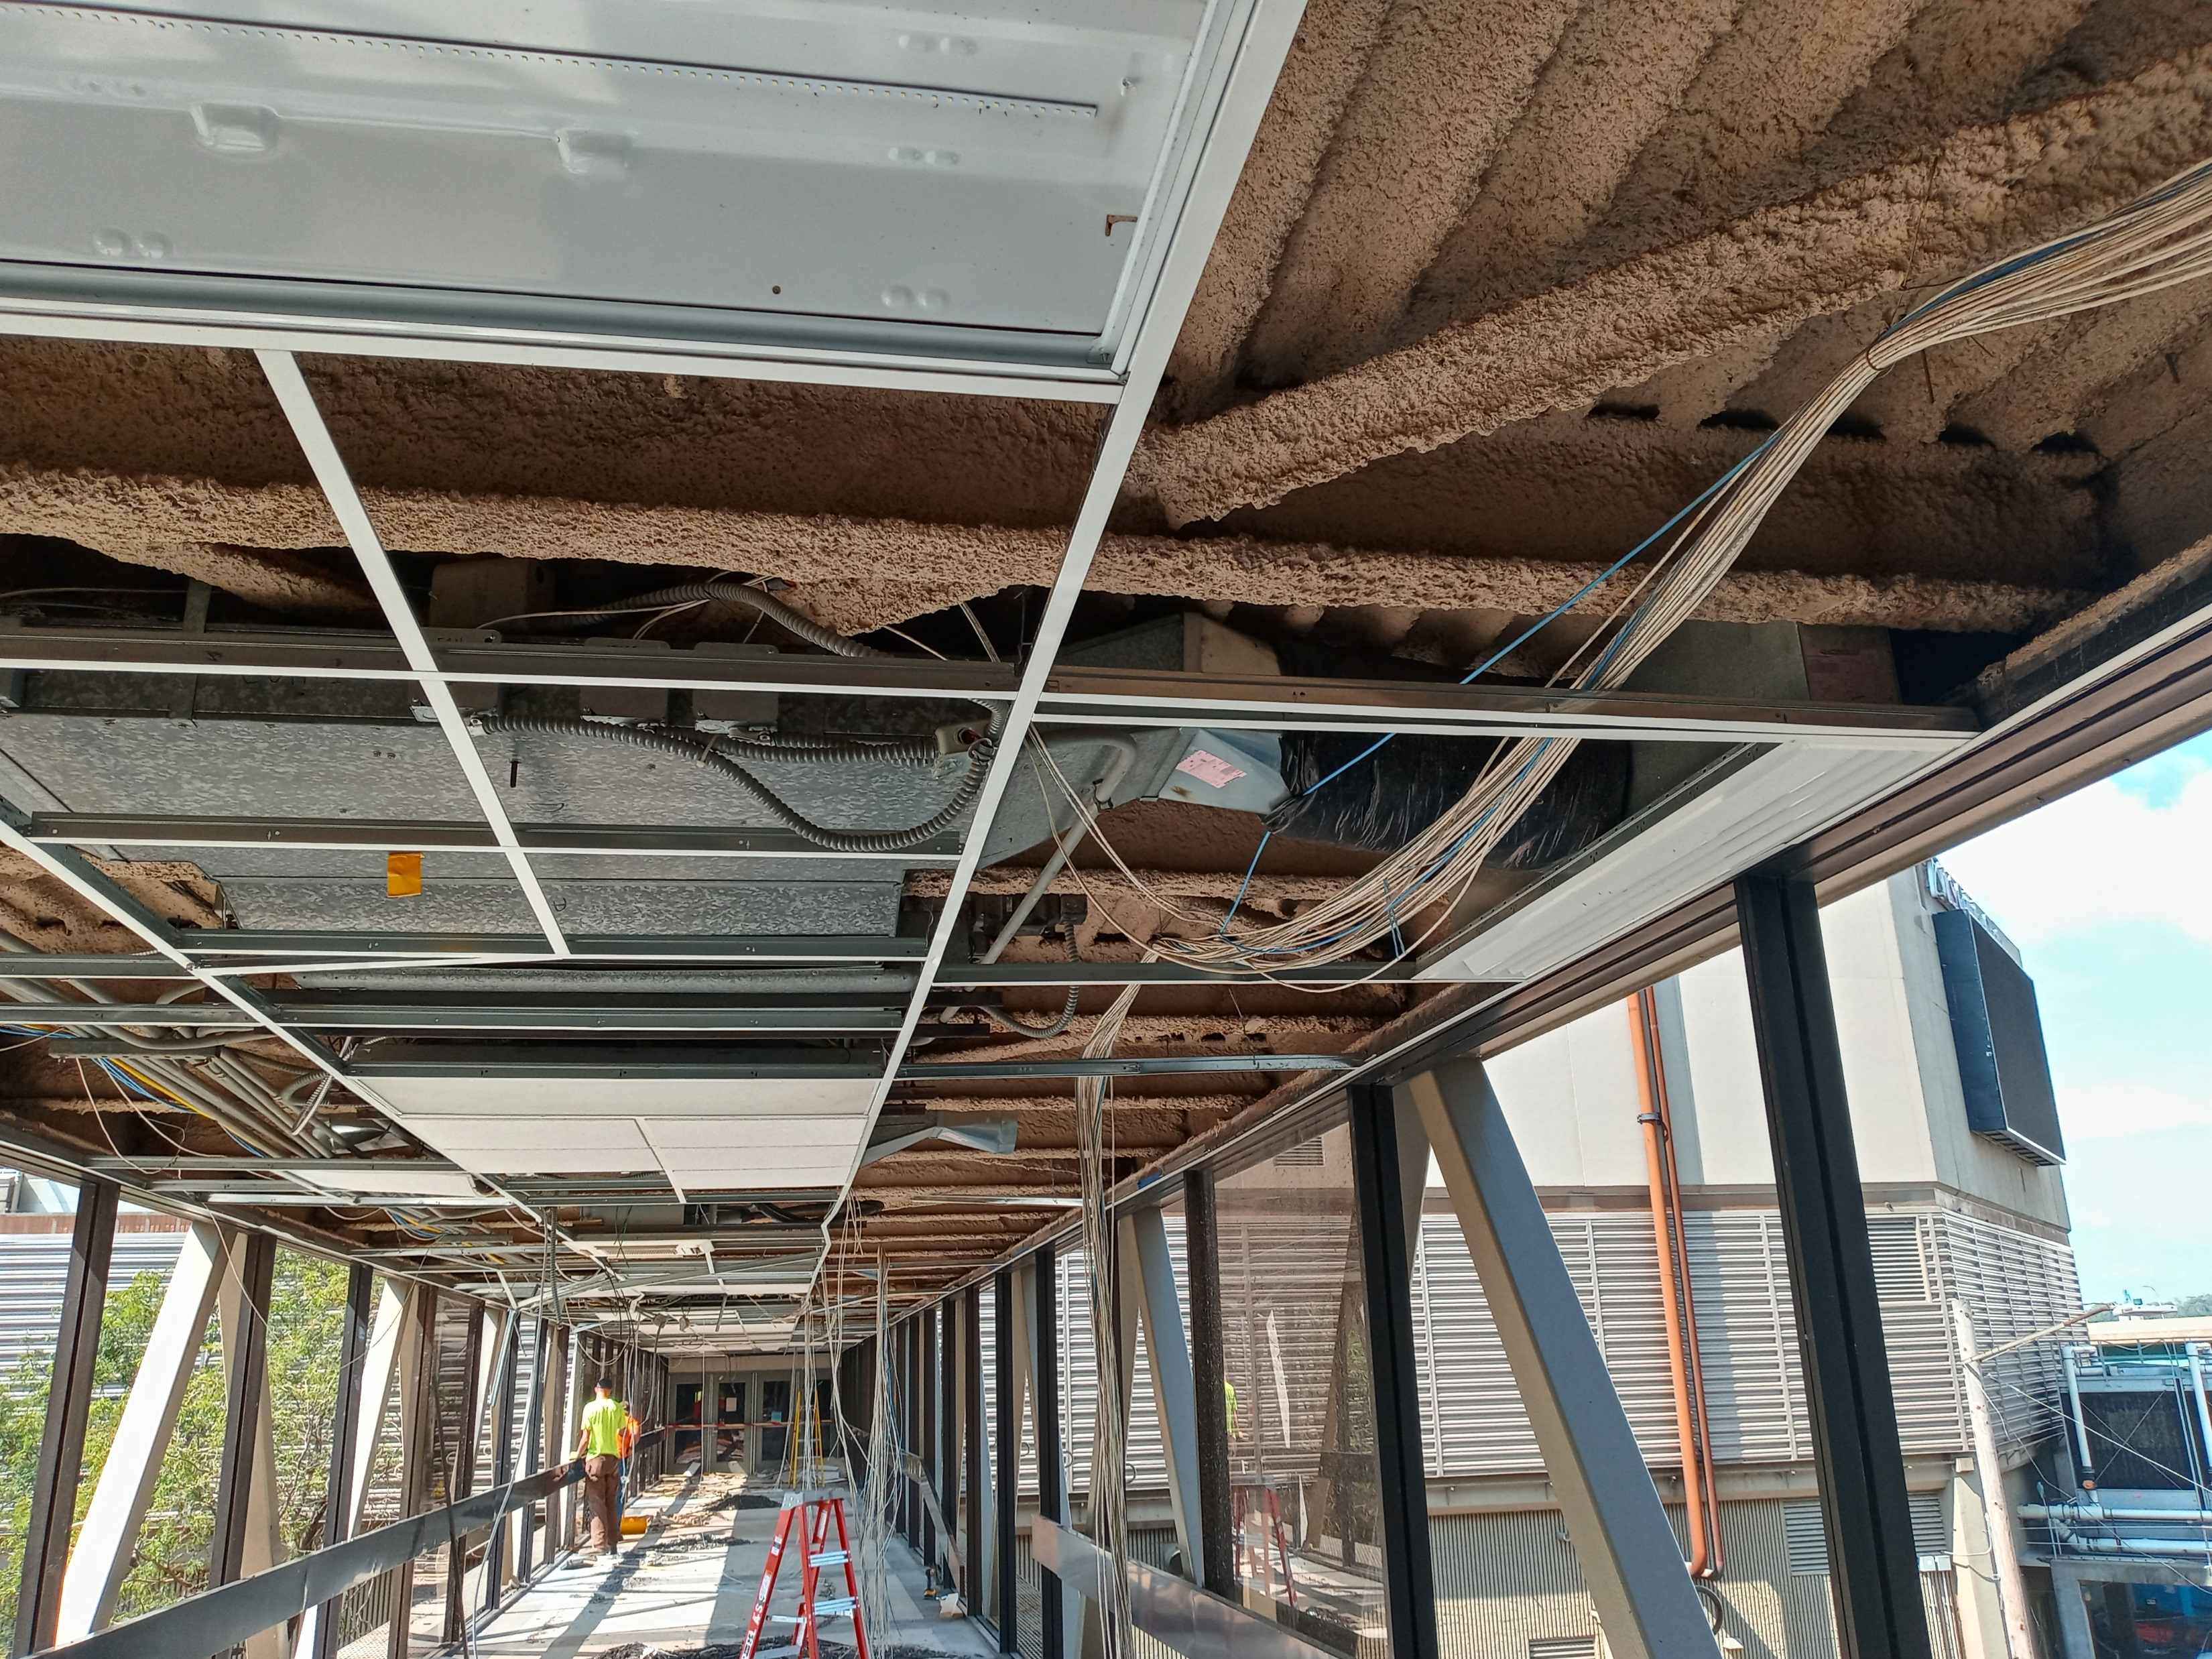
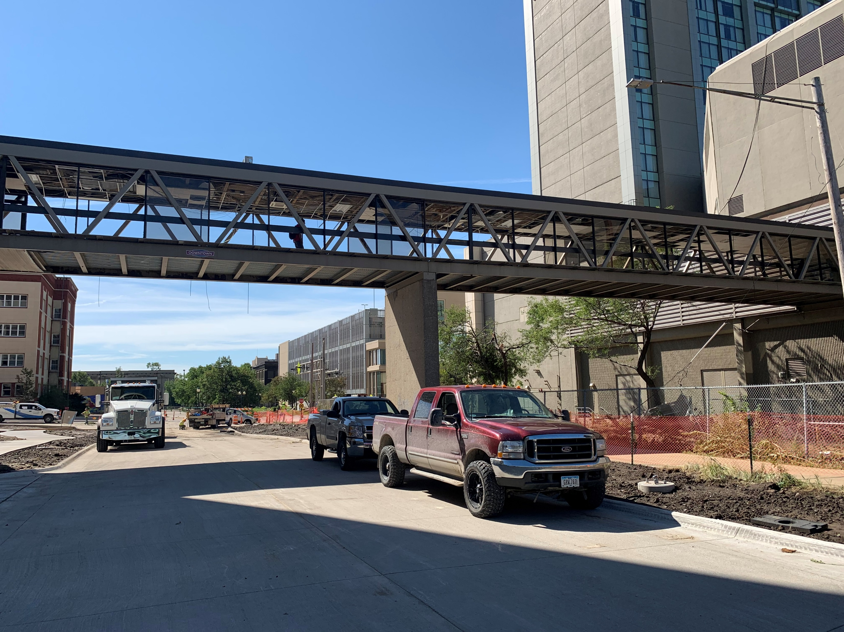

Slide 9
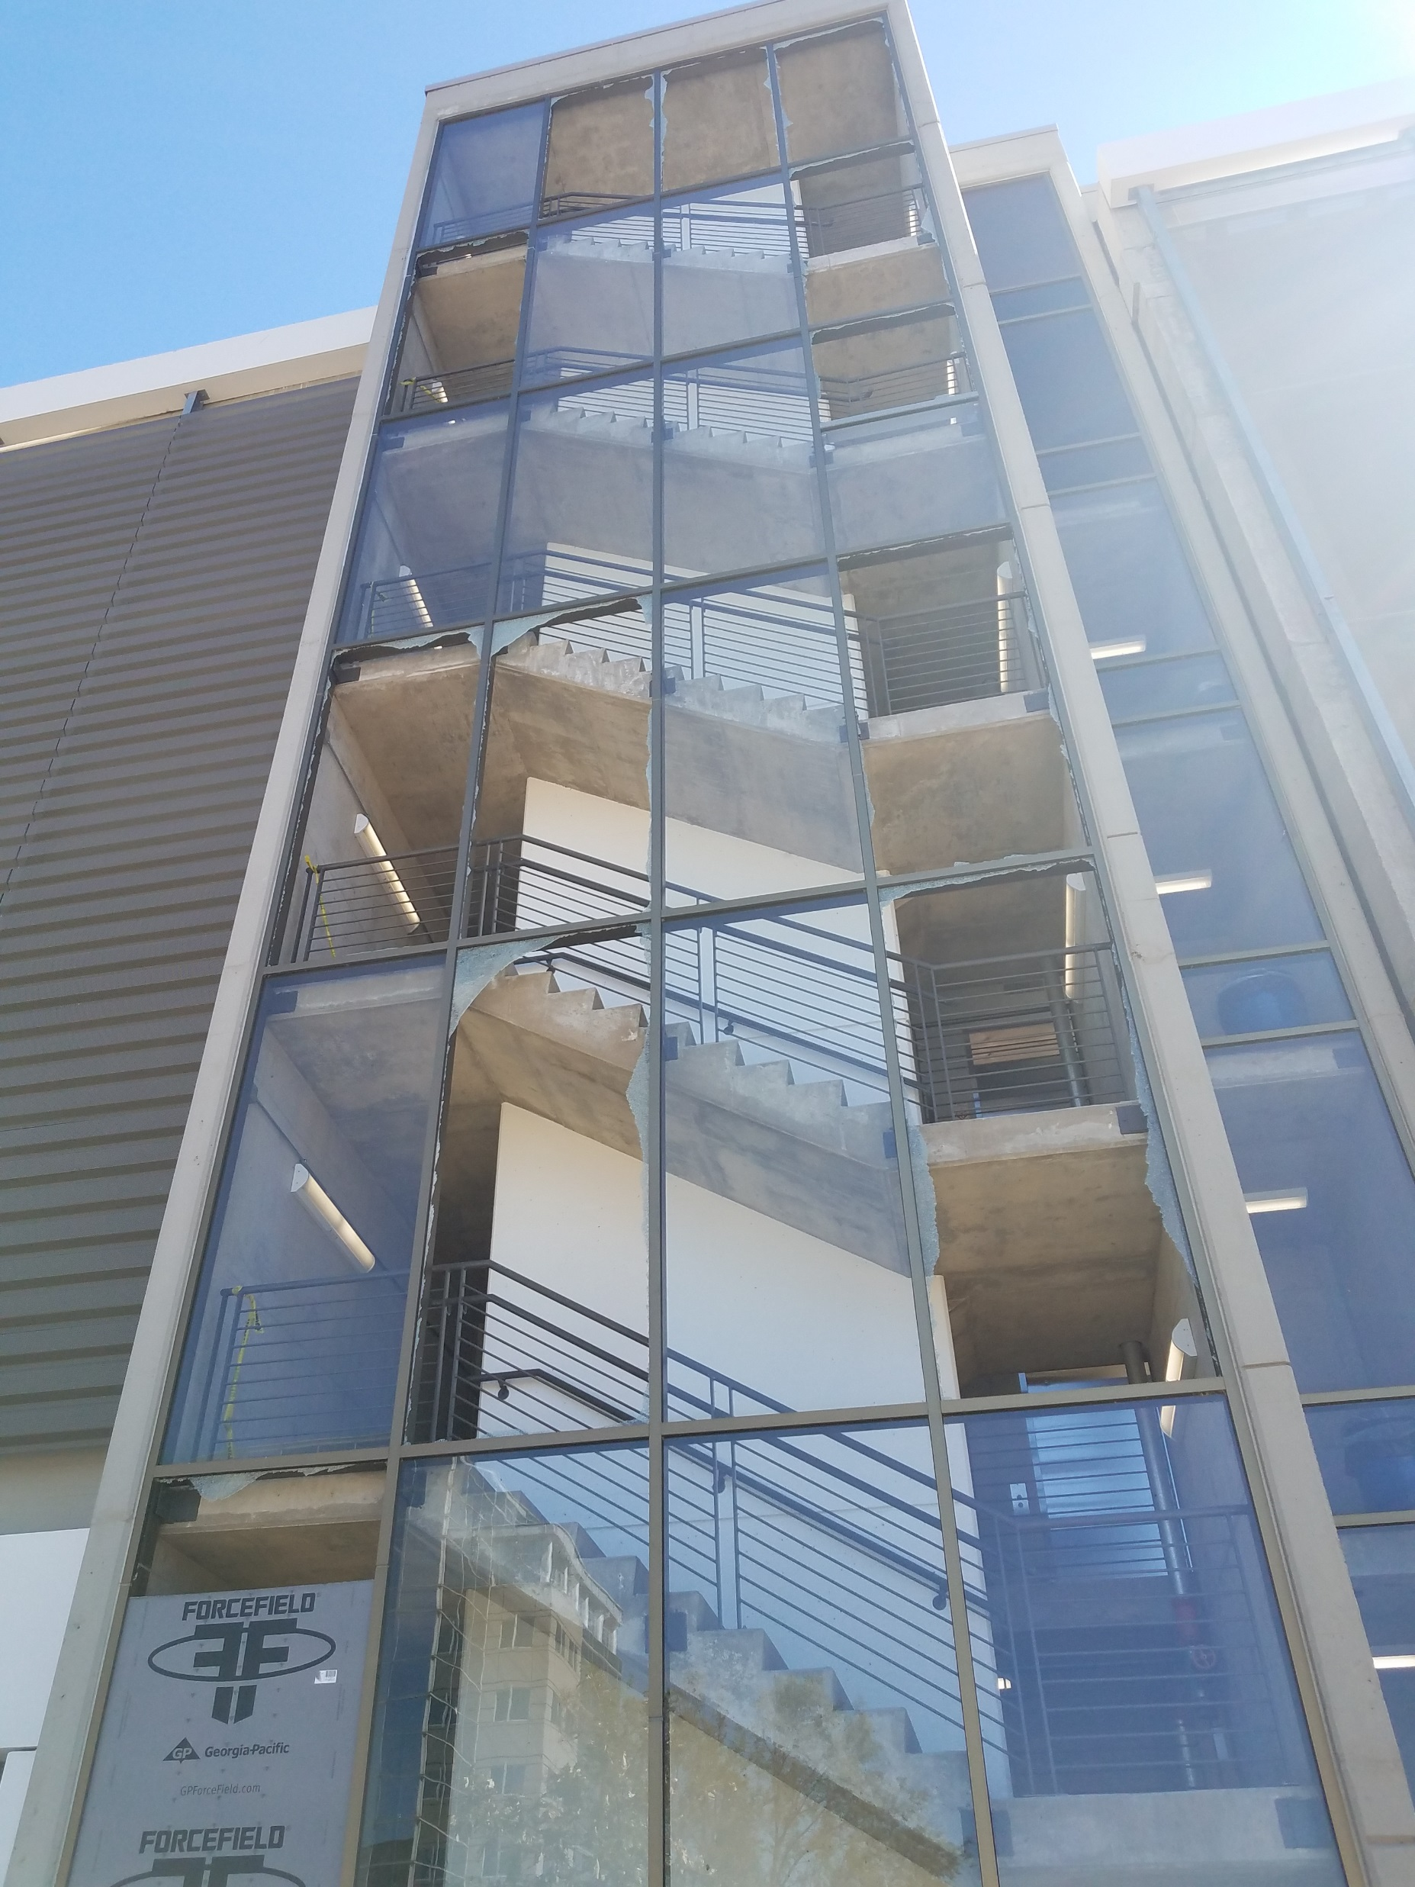

Slide 10
Questions ? / comments

